Slide 1


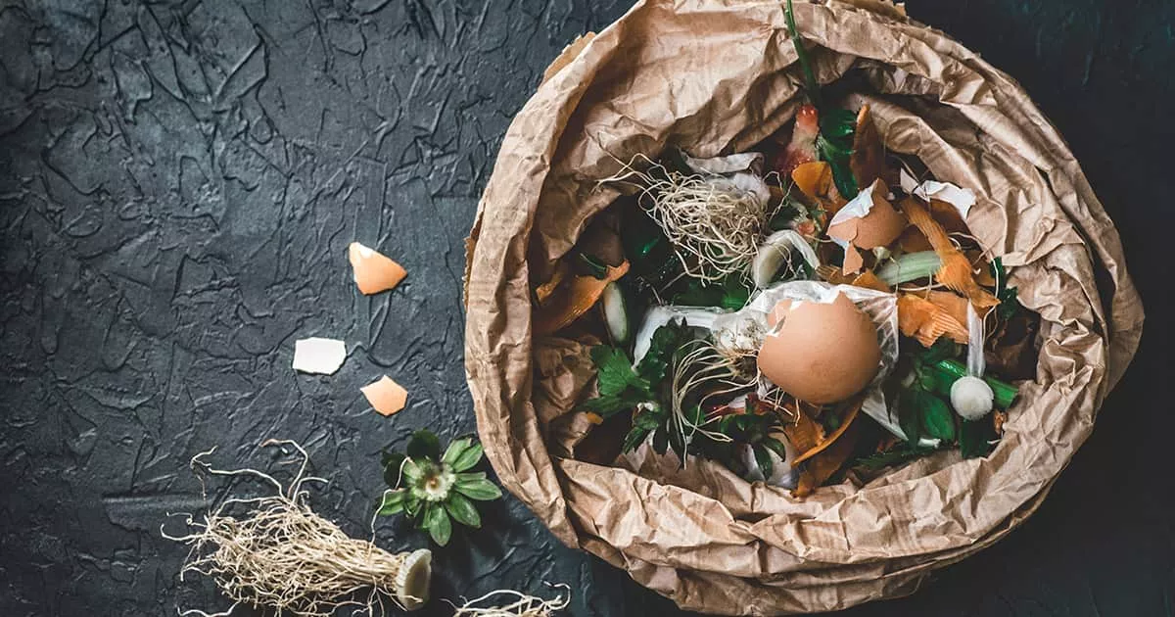

FOOD WASTE
Costras Crina-Costina
Stanciu Karina-Mihaela
Apetrei Maia

Slide 2

We asked 15 children with ages ranging between 5 and 10 years old, questions about food waste.

Slide 3

When asked if they usually finish the food on their plate:
13 out of 15 answered yes;
1 out of 15 answered no;
1 out of 15 answered sometimes.

Slide 4
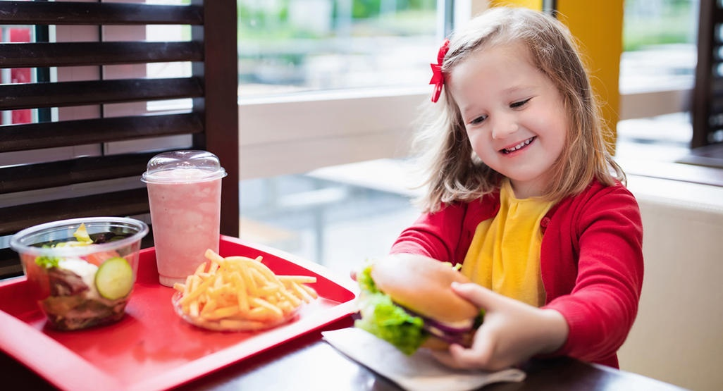
When asked the question: how often would you say you eat fast-food?
8 out of 15 answered every week or so;
7 out of 15 answered rarely.

Slide 5

When asked if they prefer homemade food or fast food:
10 out of 15 answered homemade;
4 out of 15 answered fast-food;
1 out of 15 answered both.

Slide 6

When asked if their parents prepare the food or they buy something already made:
14 out of 15 answered that their parents prepare the food;
1 out of 15 answered that sometimes they buy something already made.

Slide 7
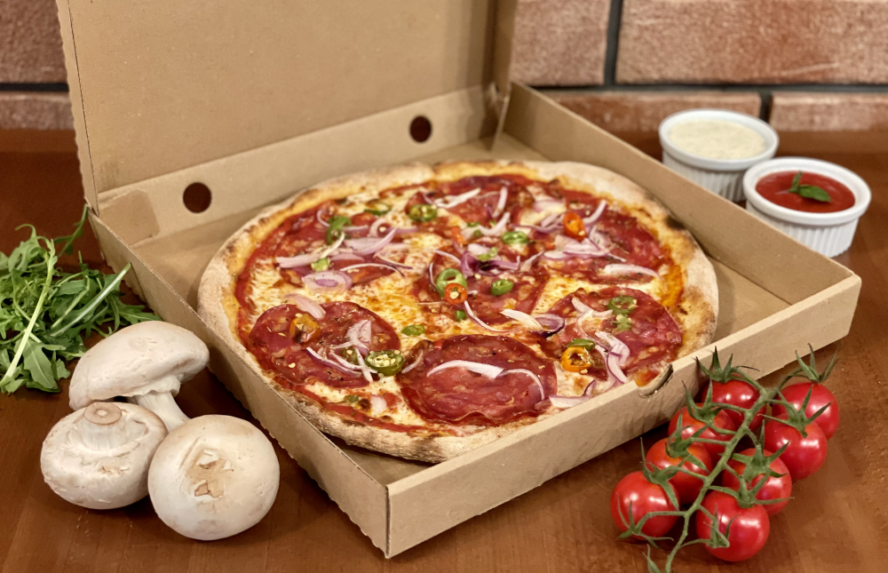
When asked the question: do you think bought food is better than homemade food?
3 out of 15 answered yes;
12 out of 15 answered no.

Slide 8

When asked the question: when your family goes to the market, do they have a shopping list?
4 out of 15 answered yes;
6 out of 15 answered no;
5 out of 15 answered sometimes.

Slide 9
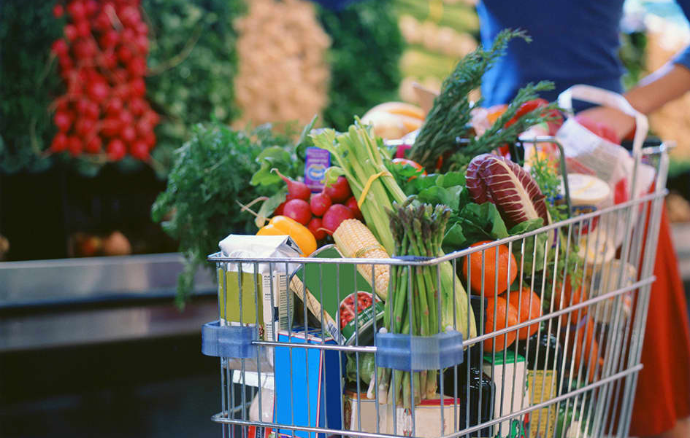
When asked the question: when your family goes to the market, do they usually buy more than is necessary?
7 out of 15 answered yes;
7 out of 15 answered no;
1 out of 15 answered sometimes.

Slide 10
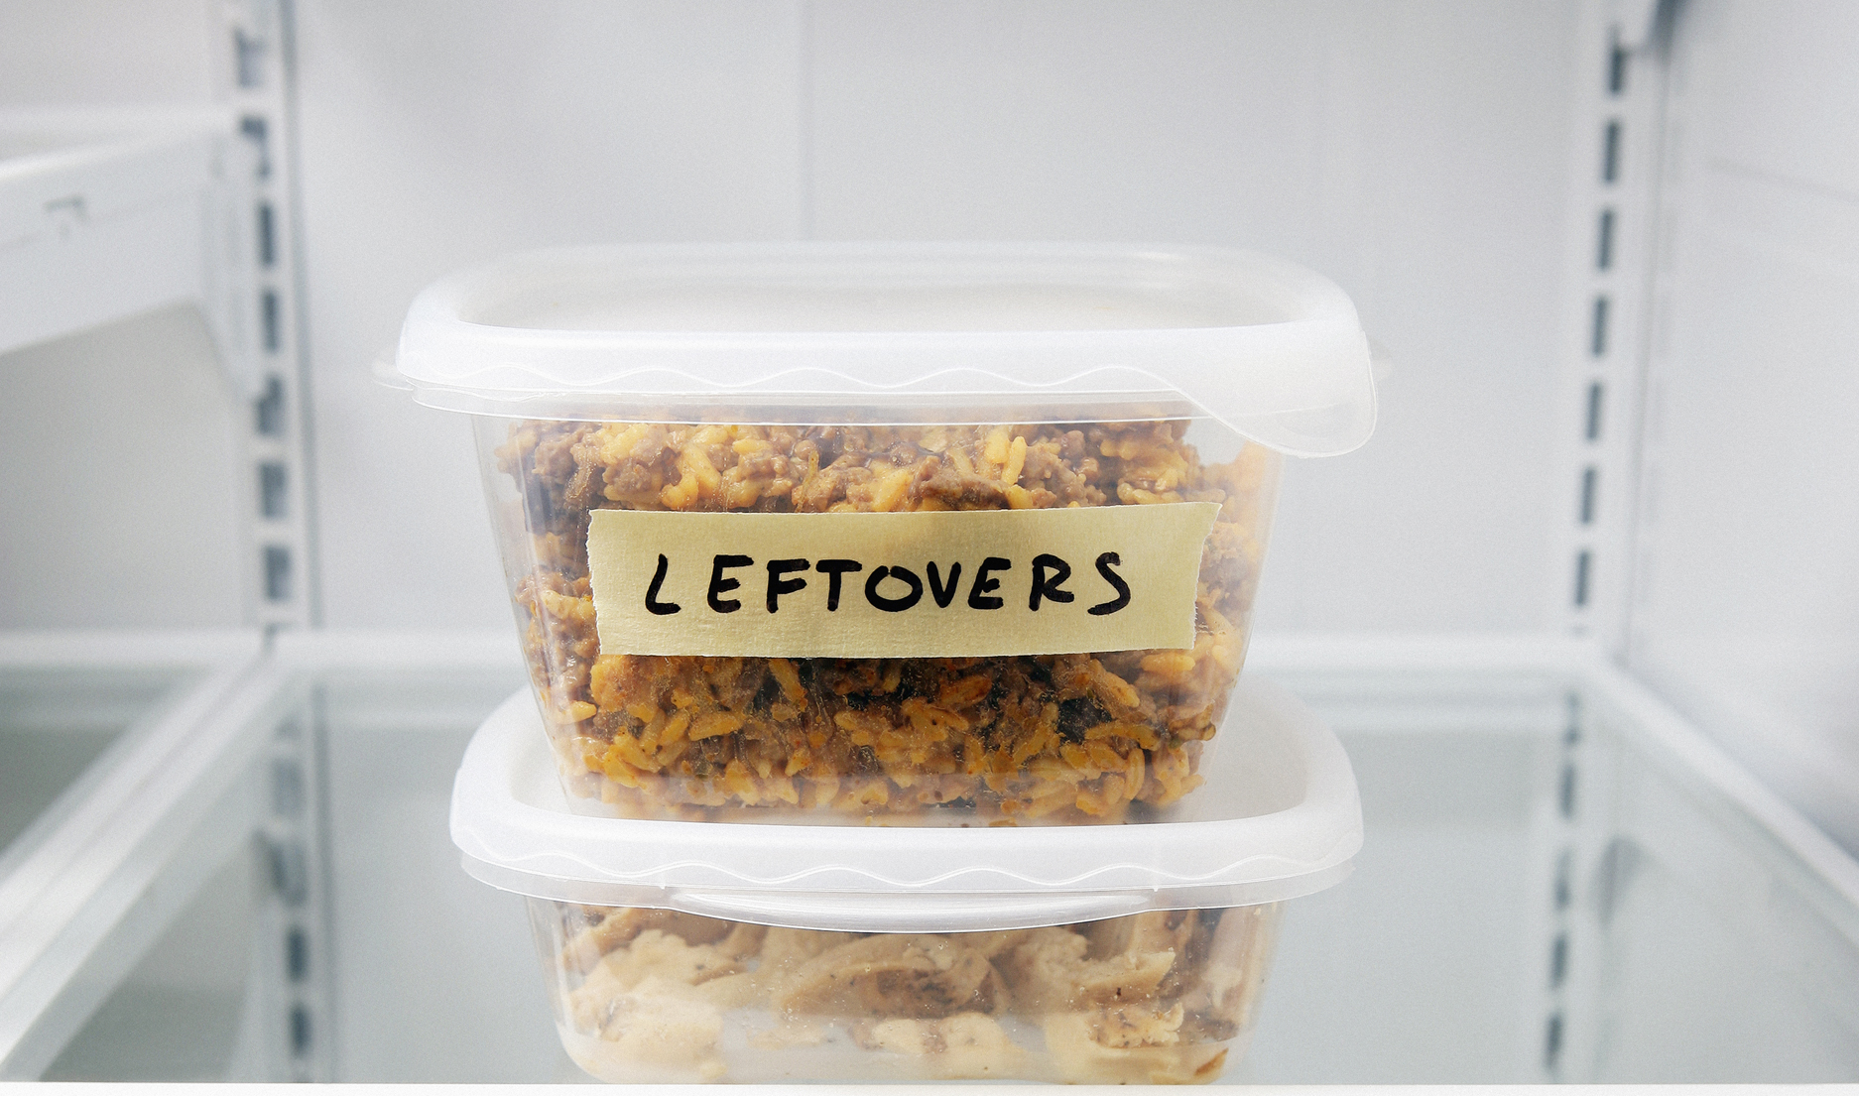
When asked the question: at home, when there are leftovers, what happens to them?
7 out of 15 answered they usually offer them to animals;
4 out of 15 answered they usually throw them away;
4 out of 15 answered they keep the leftovers to eat later.

Slide 11
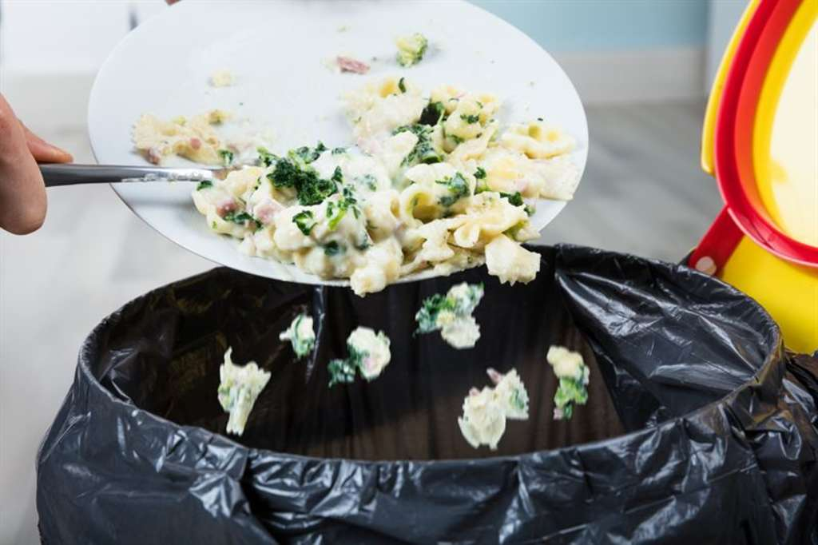
When asked if they have ever thrown away food:
11 out of 15 answered yes;
4 out of 15 answered no.

Slide 12
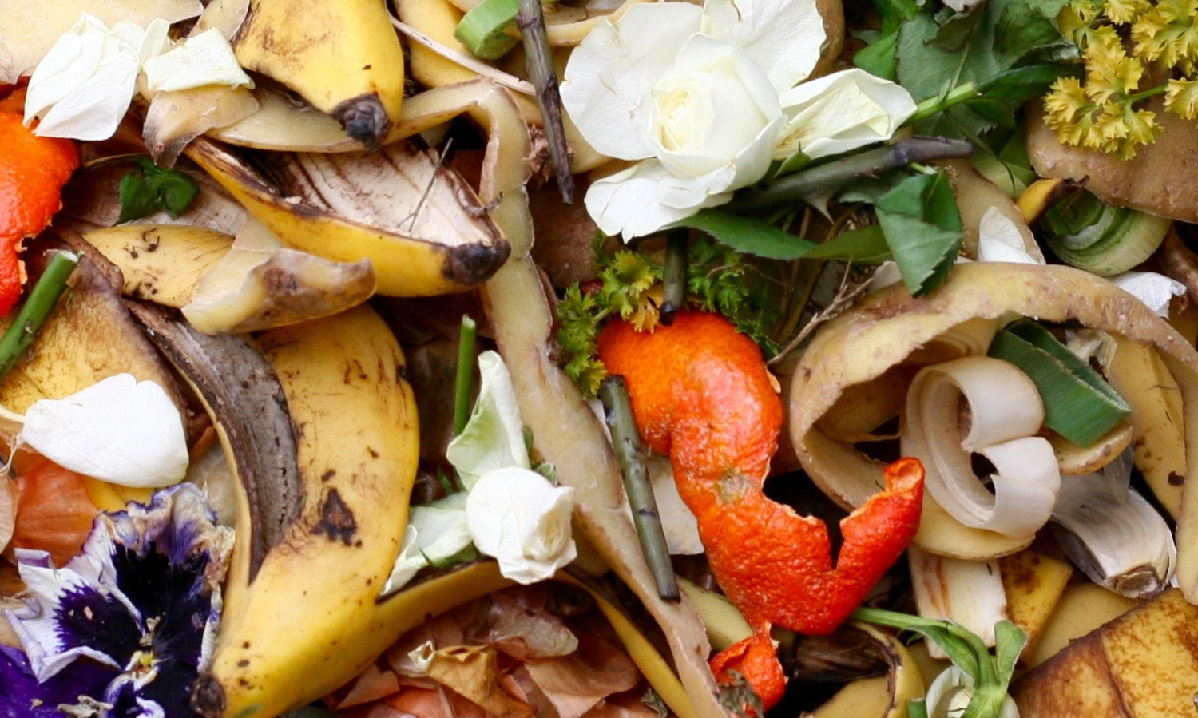
When asked if they know any consequence for wasting food:
3 out of 15 answered yes;
12 out of 15 answered no.

Slide 13
Bibliography
https://www.unep.org/news-and-stories/story/why-global-fight-tackle-food-waste-has-only-just-begun
https://parenting.firstcry.com/articles/6-ideas-to-stop-food-wastage-by-kids/
https://www.babycenter.com/toddler/feeding/healthy-fast-food-for-kids-exists-but-most-parents-arent-buy_20005010
https://vitagen.com.my/node/78
https://theconversation.com/science-says-eat-with-your-kids-34573
https://tazz.ro/oradea/pizza-box/8458/restaurant
https://www.wur.nl/en/Dossiers/file/Dossier-Food-waste.htm
https://www.cnbc.com/2016/05/11/grocery-to-landfill-confronting-what-we-waste-commentary.html
https://www.nbcnews.com/better/lifestyle/guide-leftovers-how-store-them-safely-when-toss-them-ncna868316
https://www.hospitalitynet.org/news/4095679.html
https://foodtank.com/news/2020/09/12-organizations-creating-food-products-from-upcycled-food-waste/

